Slide 1
BRANCH PREDICTION UNIT (BPU)
Presentation by,
PRATYUSH
K.S.SETHURATHNAM
ADITYA MEHRA
RIDHI

Slide 2
What is branch prediction and why we need it inside a processor?
To know about the branch prediction and the need of it we need to look into the pipelined processor and hazards associated with it.
Processors are pipelined to achieve extreme computing speed and to compute more number of instruction and data in less time and less number of machine cycles.
Due to pipelining there is a hazard associated with it called
CONTROL HAZARD !!!!

Slide 3
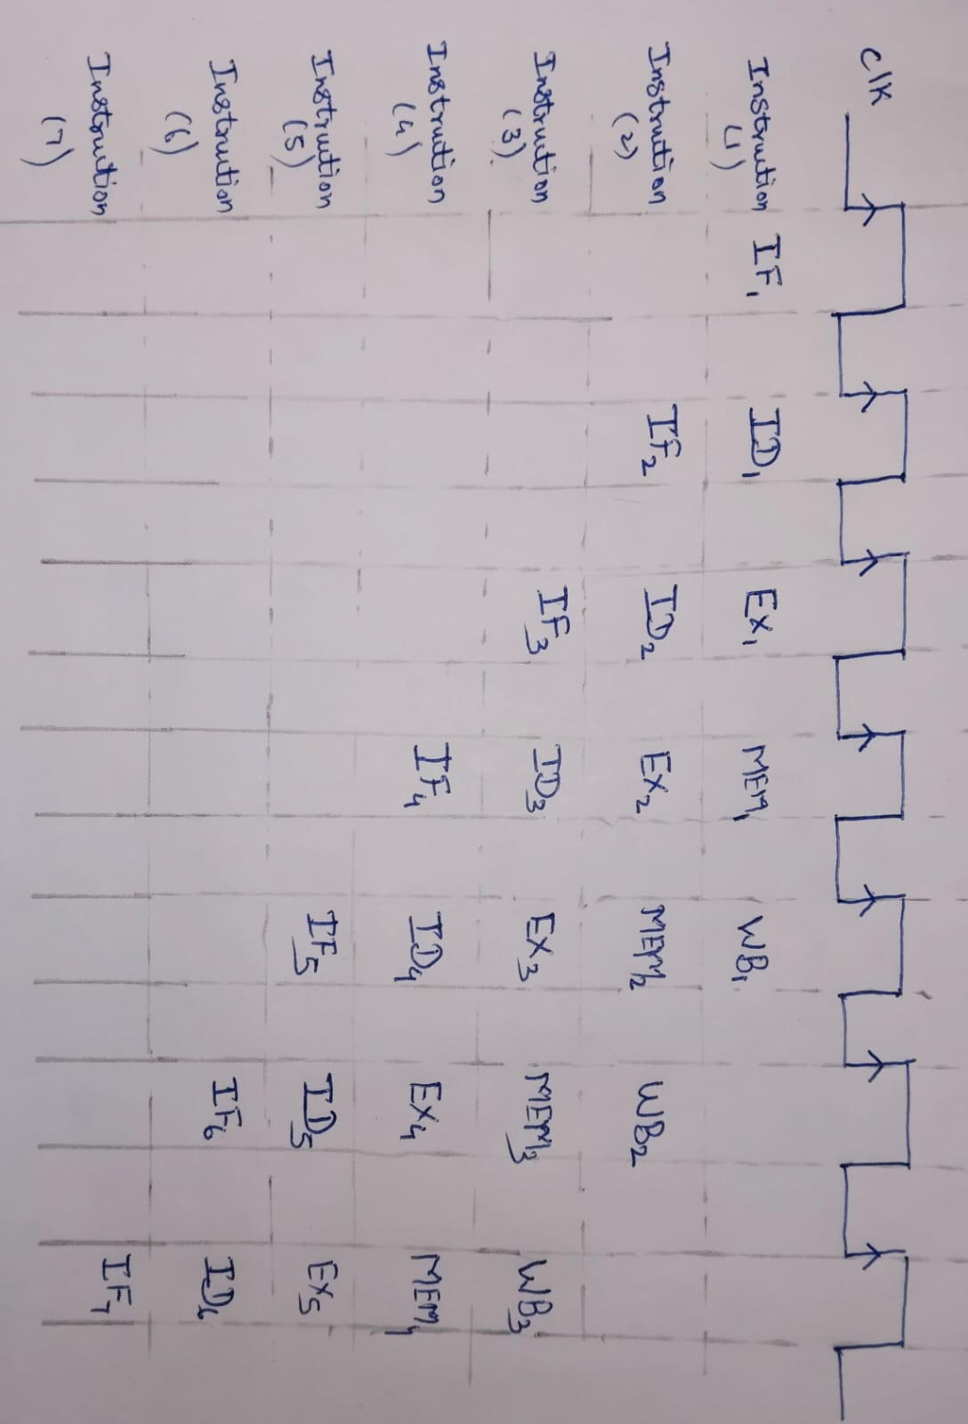
We are considering a 5 stage pipelined processor here
IF -> ID -> EX -> MEM -> WB
FIRST INSTRUCTION EXECUTED AFTER 5TH CLOCK EDGE

Slide 4
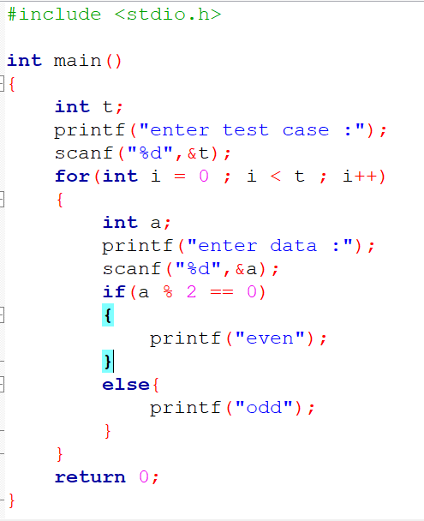
CONTROL HAZARD
Control hazard comes in the picture in case of pipelined processor when there is branch and jump related instructions present in the ISA.
if we analyse this code we could see there are conditions and loops
present and when these code got compiled these loops and conditional statements represents branches and jumps in the machine level code.

Slide 5
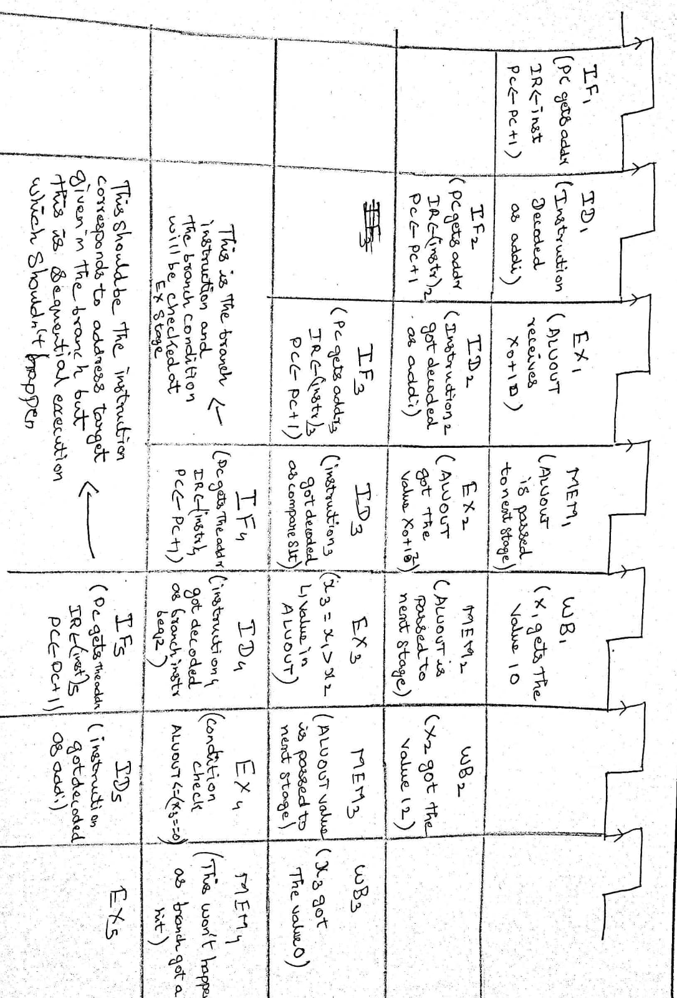
here because the branch instruction condition is getting checked at EX stage the processor loads the next two instructions sequentially which is wrong if the branch is taken and condition satisfied and this leads to the flushing of the pipeline and loading the correct instructions again and spoiling the pipeline and thus spoiling the IPC of the processor

Slide 6
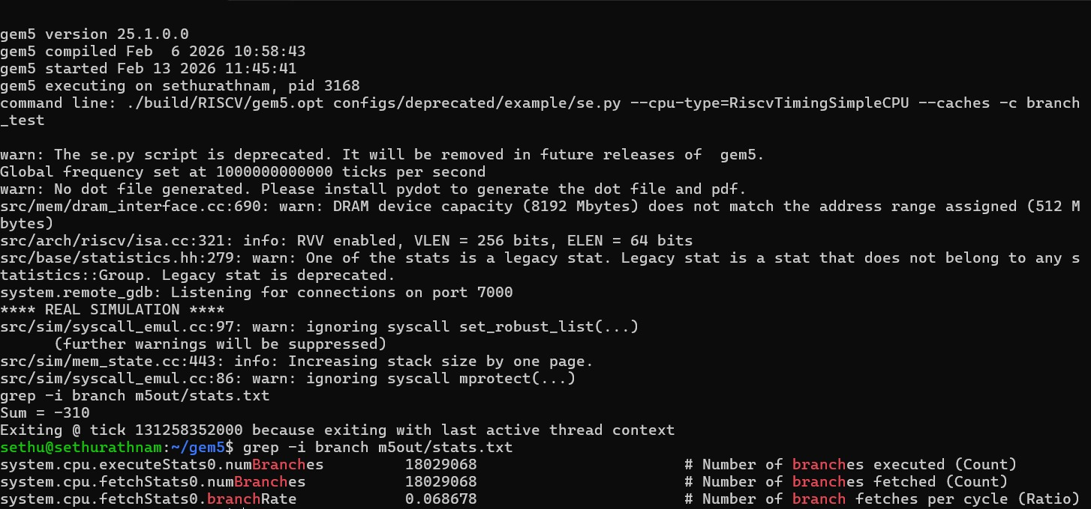

Slide 7
Choosing the GEM5 as the simulator to work on the RISCV isa processor
Gem5 is an opensource tool which allows the users to work with different kind of processor they are having in their library and also it allows the users to give different workload to the processors available to analyse the properties related to it.
So we choose gem5 as our environment to work on to decide which branch prediction algorithm to work on by analysing the results generated through the simulation on giving different kind of workloads to processor by integrating with different kind of branch prediction algorithms.

Slide 8
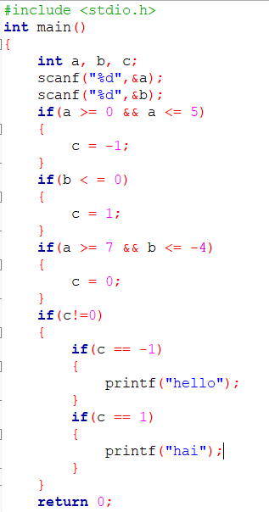
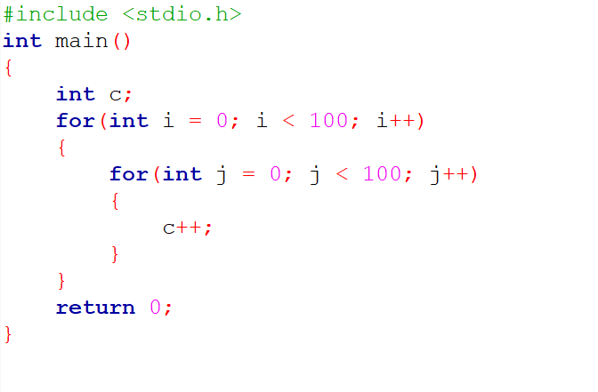
LOCAL BRANCH PREDICTOR
GLOBAL BRANCH PREDICTOR

Slide 9
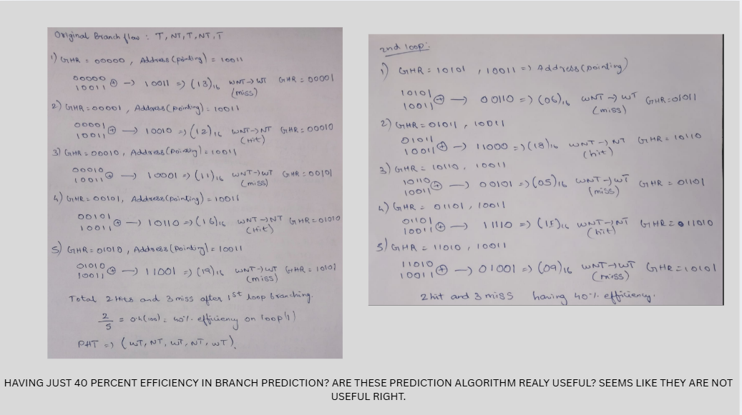
Concept of ALIASING :

Slide 10
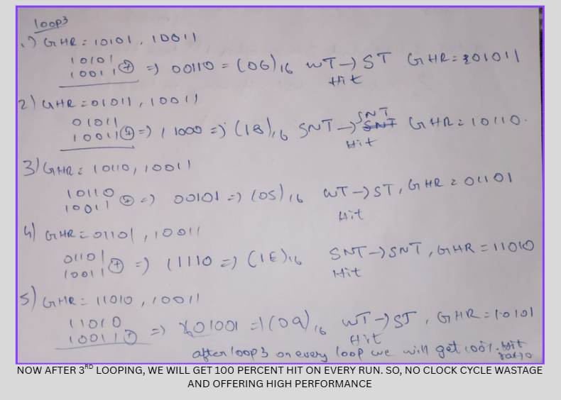

Slide 11
